Slide 1
HTML Frames

Slide 2
HTML Frames
HTML frames are used to divide your browser window into multiple sections where each section can load a separate HTML document.
A collection of frames in the browser window is known as a frameset.
The window is divided into frames in a similar way the tables are organized: into rows and columns.

Slide 3
Disadvantages of Frames
There are few drawbacks with using frames, so it’s never recommended to use frames in your webpages
Some smaller devices cannot cope with frames often because their screen is not big enough to be divided up.

Slide 4
Disadvantages of Frames
Sometimes your page will be displayed differently on different computers due to different screen resolution.
The browser's back button might not work as the user hopes.
There are still few browsers that do not support frame technology.

Slide 5
Creating Frames
To use frames on a page we use <frameset> tag instead of <body> tag.
The <frameset> tag defines how to divide the window into frames.

Slide 6
Creating Frames
The rows attribute of <frameset> tag defines horizontal frames and cols attribute defines vertical frames.
Each frame is indicated by <frame> tag and it defines which HTML document shall open into the frame.

Slide 7
Creating Frames
<html>
<head>
<title>HTML Frames</title>
</head>
<frameset rows="25%,50%,25%">
<frame name="left" src="/html/top_frame.html" />
<frame name="center" src="/html/main_frame.html“ />
<frame name="right“ src="/html/bottom_frame.htm" />
<noframes>
<body>
Your browser does not support frames.
</body>
</noframes>
</frameset>
</html>

Slide 8
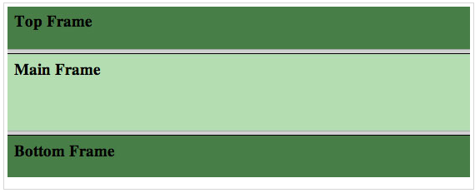
Creating Frames

Slide 9
Creating Frames
Let's put above example as follows, here we replaced rows attribute by cols.
This will create all the three frames vertically:

Slide 10
Creating Frames
<html>
<head>
<title>HTML Frames</title>
</head>
<frameset cols="25%,50%,25%">
<frame name="left" src="/html/top_frame.htm" />
<frame name="center" src="/html/main_frame.htm" />
<frame name="right" src="/html/bottom_frame.htm" />
<noframes>
<body>
Your browser does not support frames.
</body>
</noframes>
</frameset>
</html>

Slide 11
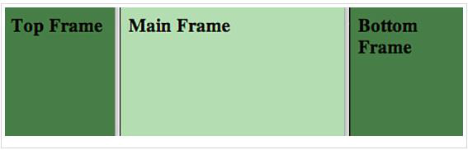
Creating Frames

Slide 12
The <frameset> Tag Attributes
cols
specifies how many columns are contained in the frameset and the size of each column.
You can specify the width of each column in one of four ways:

Slide 13
The <frameset> Tag Attributes
Absolute values in pixels.
For example to create three vertical frames, use cols="100, 500,100".
A percentage of the browser window.
For example to create three vertical frames, use cols="10%, 80%,10%".

Slide 14
The <frameset> Tag Attributes
Using a wildcard symbol.
For example to create three vertical frames, use cols="10%, *,10%".
In this case wildcard takes remainder of the window.

Slide 15
The <frameset> Tag Attributes
As relative widths of the browser window.
For example to create three vertical frames, use cols="3*,2*,1*".
This is an alternative to percentages.
You can use relative widths of the browser window.
Here the window is divided into sixths: the first column takes up half of the window, the second takes one third, and the third takes one sixth.

Slide 16
The <frameset> Tag Attributes
rows
This attribute works just like the cols attribute and takes the same values, but it is used to specify the rows in the frameset.

Slide 17
The <frameset> Tag Attributes
For example to create two horizontal frames, use rows="10%, 90%".
You can specify the height of each row in the same way as explained above for columns.

Slide 18
The <frameset> Tag Attributes
border
This attribute specifies the width of the border of each frame in pixels.
For example border="5".
A value of zero means no border.

Slide 19
The <frameset> Tag Attributes
frameborder
This attribute specifies whether a three-dimensional border should be displayed between frames.
This attribute takes value either 1 (yes) or 0 (no).
For example frameborder="0“ specifies no border.

Slide 20
The <frameset> Tag Attributes
framespacing
This attribute specifies the amount of space between frames in a frameset.
This can take any integer value.
For example framespacing="10" means there should be 10 pixels spacing between each frames.

Slide 21
The <frame> Tag Attributes
src
This attribute is used to give the file name that should be loaded in the frame.
Its value can be any URL.
For example, src="/html/top_frame.htm" will load an HTML file available in html directory.

Slide 22
The <frame> Tag Attributes
name
This attribute allows you to give a name to a frame.
It is used to indicate which frame a document should be loaded into.
This is especially important when you want to create links in one frame that load pages into another frame, in which case the second frame needs a name to identify itself as the target of the link.

Slide 23
The <frame> Tag Attributes
frameborder
This attribute specifies whether or not the borders of that frame are shown; it overrides the value given in the frameborder attribute on the <frameset> tag if one is given, and this can take values either 1 (yes) or 0 (no).

Slide 24
The <frame> Tag Attributes
marginwidth
This attribute allows you to specify the width of the space between the left and right of the frame's borders and the frame's content.
The value is given in pixels.
For example marginwidth="10".

Slide 25
The <frame> Tag Attributes
marginheight
This attribute allows you to specify the height of the space between the top and bottom of the frame's borders and its contents.
The value is given in pixels.
For example marginheight="10".

Slide 26
The <frame> Tag Attributes
noresize
By default you can resize any frame by clicking and dragging on the borders of a frame.
The noresize attribute prevents a user from being able to resize the frame.
For example noresize="noresize".

Slide 27
The <frame> Tag Attributes
scrolling
This attribute controls the appearance of the scrollbars that appear on the frame.
This takes values either "yes", "no" or "auto".
For example scrolling="no" means it should not have scroll bars.

Slide 28
The <frame> Tag Attributes
longdesc
This attribute allows you to provide a link to another page containing a long description of the contents of the frame.
For example longdesc="framedescription.htm"

Slide 29
Browser Support for Frames
If a user is using any old browser or any browser which does not support frames then <noframes> element should be displayed to the user.

Slide 30
Browser Support for Frames
So you must place a <body> element inside the <noframes> element because the <frameset> element is supposed to replace the <body> element, but if a browser does not understand <frameset> element then it should understand what is inside the <body> element which is contained in a <noframes> element.

Slide 31
Frame's name and target attributes
One of the most popular uses of frames is to place navigation bars in one frame and then load main pages into a separate frame.
Let's see following example where a test.htm file has following code:

Slide 32
Frame's name and target attributes
<html>
<head>
<title>HTML Target Frames</title>
</head>
<frameset cols="200, *">
<frame src="menu.html" name="menu_page" />
<frame src="main.html" name="main_page" />
<noframes>
<body>
Your browser does not support frames.
</body>
</noframes>
</frameset>
</html>

Slide 33
Frame's name and target attributes
Here we have created two columns to fill with two frames.
The first frame is 200 pixels wide and will contain the navigation menubar implemented by menu.htm file.
The second column fills in remaining space and will contain the main part of the page and it is implemented by main.htm file.

Slide 34
Frame's name and target attributes
For all the three links available in menubar, we have mentioned target frame as main_page, so whenever you click any of the links in menubar, available link will open in main_page.

Slide 35
Frame's name and target attributes
Following is the content of menu.htm file
<html>
<body bgcolor="#4a7d49">
<a href="http://www.google.com" target="main_page">Google</a>
<br /><br />
<a href="http://www.microsoft.com" target="main_page">Microsoft</a>
<br /><br />
<a href="http://news.bbc.co.uk" target="main_page">BBC News</a>
</body>
</html>

Slide 36
Frame's name and target attributes
Following is the content of main.htm file:
<html>
<body bgcolor="#b5dcb3">
<h3>This is main page and content from any link will be displayed here.</h3>
<p>So now click any link and see the result.</p>
</body>
</html>

Slide 37
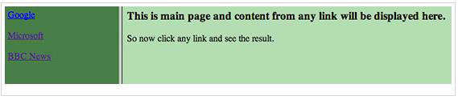
Frame's name and target attributes
When we load test.htm file, it produces following result:

Slide 38
HTML IFrames
You can define an inline frame with HTML tag <iframe>. The <iframe> tag is not somehow related to <frameset> tag, instead, it can appear anywhere in your document.
The <iframe> tag defines a rectangular region within the document in which the browser can display a separate document, including scrollbars and borders.

Slide 39
HTML IFrames
The src attribute is used to specify the URL of the document that occupies the inline frame.
Following is the example to show how to use the <iframe>

Slide 40
HTML IFrames
<html>
<head>
<title>HTML Iframes</title>
</head>
<body>
<p>Document content goes here...</p>
<iframe src="/html/menu.htm" width="555" height="200">
Sorry your browser does not support inline frames.
</iframe>
<p>Document content also go here...</p>
</body>
</html>

Slide 41
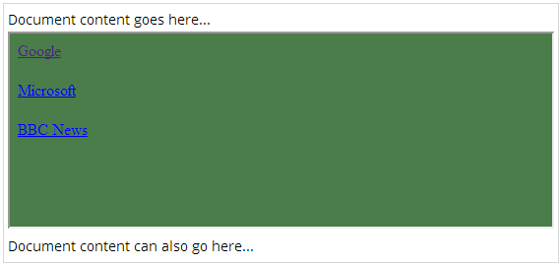
HTML IFrames
This will produce following result:

Slide 42
The <Iframe> Tag Attributes
Most of the attributes of the <iframe> tag, including name, class, frameborder, id, longdesc, marginheight, marginwidth, name, scrolling, style, and title behave exactly like the corresponding attributes for the <frame> tag.

Slide 43
HTML Blocks
All the HTML elements can be categorized into two categories (a) Block Level Elements (b) Inline Elements

Slide 44
Block Elements
Block elements appear on the screen as if they have a line break before and after them.
For example the <p>, <h1>, <h2>, <h3>, <h4>, <h5>, <h6>, <ul>, <ol>, <dl>, <pre>, <hr />, <blockquote>, and <address> elements are all block level elements.
They all start on their own new line, and anything that follows them appears on its own new line.

Slide 45
Inline Elements
Inline elements, on the other hand, can appear within sentences and do not have to appear on a new line of their own.
The <b>, <i>, <u>, <em>, <strong>, <sup>, <sub>, <big>, <small>, <li>, <ins>, <del>, <code>, <cite>, <dfn>, <kbd>, and <var> elements are all inline elements.

Slide 46
Grouping HTML Elements
There are two important tags which we use very frequently to group various other HTML tags (i) <div> tag and (ii) <span> tag

Slide 47
The <div> tag
This is the very important block level tag which plays a big role in grouping various other HTML tags and applying CSS on group of elements.
Even now <div> tag can be used to create webpage layout where we define different parts (Left, Right, Top etc.) of the page.

Slide 48
The <div> tag
This tag does not provide any visual change on the block but this has more meaning when it is used with CSS.

Slide 49
The <div> tag
<html>
<head>
<title>HTML div Tag</title>
</head>
<body>
<!-- First group of tags -->
<div style="color:red">
<h4>This is first group</h4>
<p>Following is a list of vegetables</p>
<ul>
<li>Beetroot</li>
<li>Ginger</li>
<li>Potato</li>
<li>Radish</li>
</ul>
</div>
<!-- Second group of tags -->
<div style="color:green">
<h4>This is second group</h4>
<p>Following is a list of fruits</p>
<ul>
<li>Apple</li>
<li>Banana</li>
<li>Mango</li>
<li>Strawberry</li>
</ul>
</div>
</body>
</html>

Slide 50
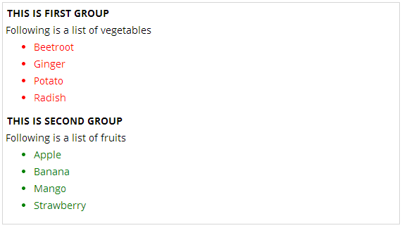
The <div> tag
This will produce following result:

Slide 51
The <span> tag
The HTML <span> is an inline element and it can be used to group inline elements in an HTML document.
This tag also does not provide any visual change on the block but has more meaning when it is used with CSS.

Slide 52
The <span> tag
The difference between the <span> tag and the <div> tag is that the <span> tag is used with inline elements whereas the <div> tag is used with block-level elements.

Slide 53
The <span> tag
<html>
<head>
<title>HTML span Tag</title>
</head>
<body>
<p>This is <span style="color:red">red</span> and this is <span style="color:blue">green</
span></p>
</body>
</html>

Slide 54
The <span> tag
This will produce following result:

Slide 55
HTML Backgrounds
By default, your webpage background is white in color.
You may not like it, but no worries. HTML provides you following two good ways to decorate your webpage background.
Html Background with Colors
Html Background with Images

Slide 56
Html Background with Colors
The bgcolor attribute is used to control the background of an HTML element, specifically page body and table backgrounds.
Following is the syntax to use bgcolor attribute with any HTML tag.
<tagname bgcolor="color_value"...>

Slide 57
Html Background with Colors
This color_value can be given in any of the following formats:
<!-- Format 1 - Use color name -->
<table bgcolor="lime" >
<!-- Format 2 - Use hex value -->
<table bgcolor="#f1f1f1" >
<!-- Format 3 - Use color value in RGB terms -->
<table bgcolor="rgb(0,0,120)" >

Slide 58
Html Background with Colors
<html>
<head>
<title>HTML Background Colors</title>
</head>
<body>
<!-- Format 1 - Use color name -->
<table bgcolor="yellow" width="100%">
<tr><td>
This background is yellow
</td></tr>
</table>
<!-- Format 2 - Use hex value -->
<table bgcolor="#6666FF" width="100%">
<tr><td>
This background is sky blue
</td></tr>
</table>
<!-- Format 3 - Use color value in RGB terms -->
<table bgcolor="rgb(255,0,255)" width="100%">
<tr><td>
This background is green
</td></tr>
</table>
</body>
</html>

Slide 59

Html Background with Colors
This will produce following result:

Slide 60
Html Background with Images
The background attribute can also be used to control the background of an HTML element, specifically page body and table backgrounds.
You can specify an image to set background of your HTML page or table.
Following is the syntax to use background attribute with any HTML tag.

Slide 61
Html Background with Images
Note: The background attribute is deprecated and it is recommended to use Style Sheet for background setting.
<tagname background="Image URL"...>
The most frequently used image formats are JPEG, GIF and PNG images.

Slide 62
Html Background with Images
<html>
<head>
<title>HTML Background Images</title>
</head>
<body>
<!-- Set table background -->
<table background="/images/html.gif" width="100%" height="100">
<tr><td>
This background is filled up with HTML image.
</td></tr>
</table>
</body>
</html>

Slide 63

Html Background with Images
This will produce following result:

Slide 64
Patterned & Transparent Backgrounds
You might have seen many pattern or transparent backgrounds on various websites.
This simply can be achieved by using patterned image or transparent image in the background.

Slide 65
Patterned & Transparent Backgrounds
It is suggested that while creating patterns or transparent GIF or PNG images, use the smallest dimensions possible even as small as 1x1 to avoid slow
loading.

Slide 66
Patterned & Transparent Backgrounds
<html>
<head>
<title>HTML Background Images</title>
</head>
<body>
<!-- Set a table background using pattern -->
<table background="/images/pattern1.gif" width="100%" height="100">
<tr><td>
This background is filled up with a pattern image.
</td></tr>
</table>
<!-- Another example on table background using pattern -->
<table background="/images/pattern2.gif" width="100%" height="100">
<tr><td>
This background is filled up with a pattern image.
</td></tr>
</table>
</body>
</html>

Slide 67
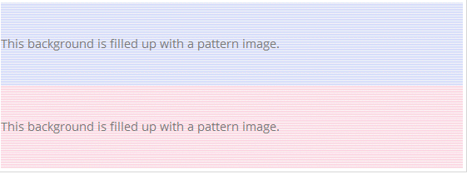
Patterned & Transparent Backgrounds
This will produce following result:

